Slide 1

The Black Box Bop-it
Team: Upsilon

Slide 2
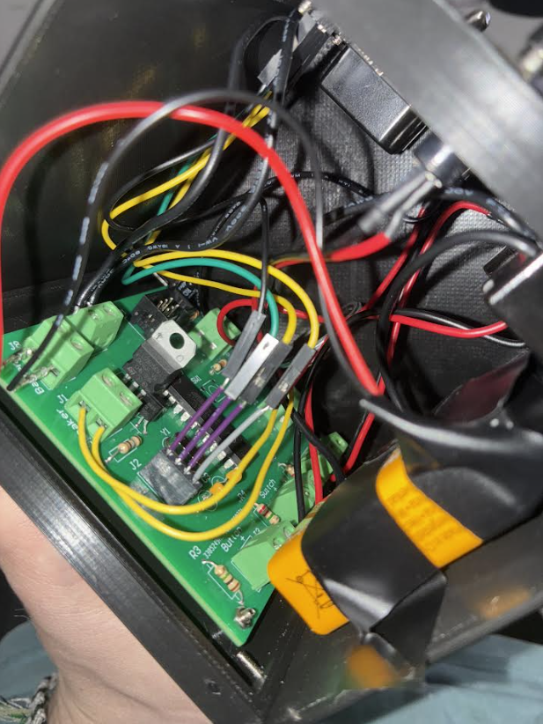
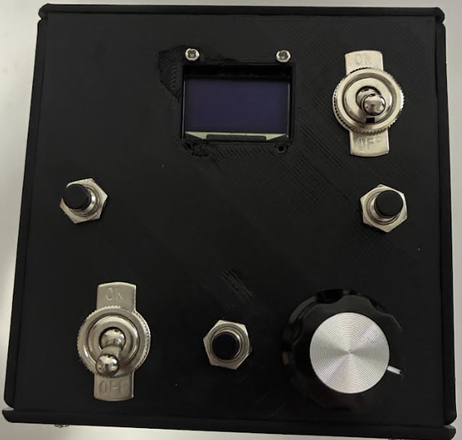
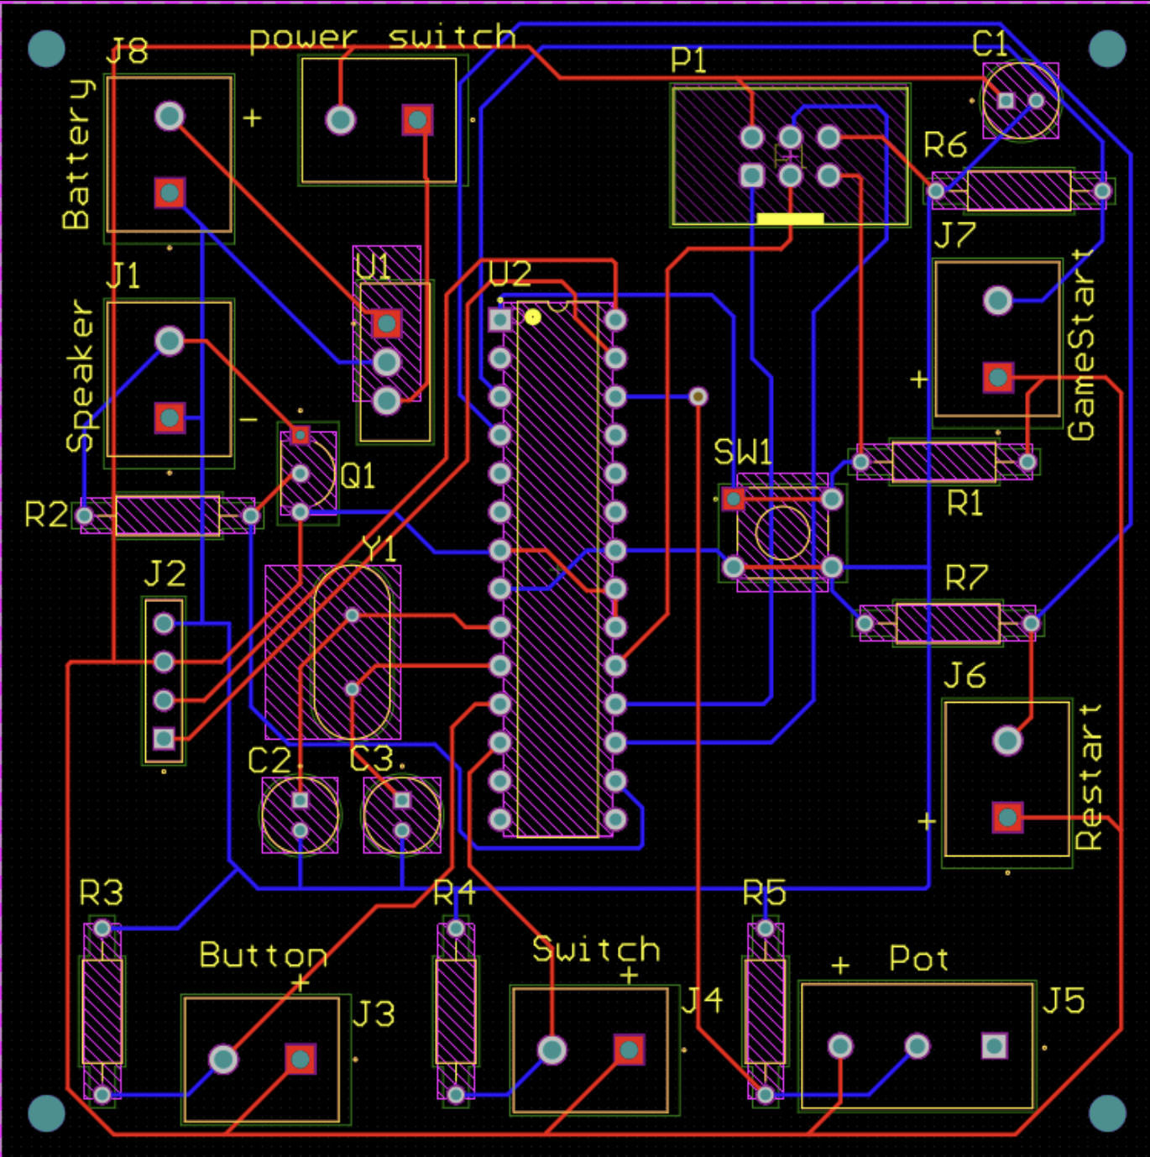
Our Design
Display
Reset
Reset
Game Start
Flip
Push
Twist

Slide 3
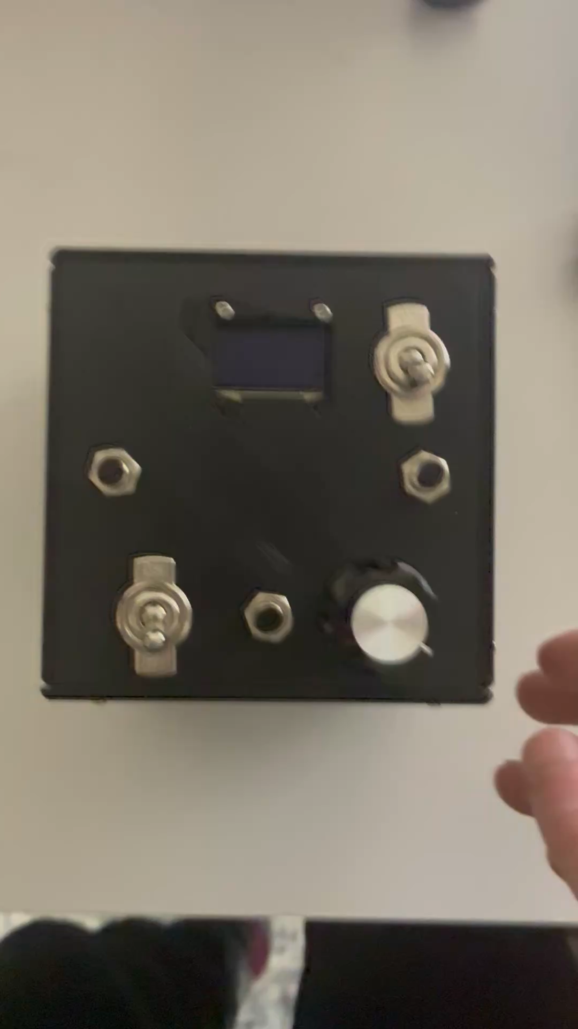
Live Demo!!!
video just in case:

Slide 4
Challenges
3D Printing Challenges
Adhesion to build plate
Defect

